Slide 1
4.1 Functions
A sequence of reusable statements that performs a desired operation
What are the benefits of using a function?

Slide 2

4.1 Functions
A sequence of reusable statements that performs a desired operation
Syntax
Contains a header and a body
Python syntax without a return value
Example 4.1: a function that takes as parameter a string representing the name of the user and print a personalised salutation to the user
function header
def functionName(list of parameters):
funtionStatementblock
function body

Slide 3

4.1 Functions
Syntax
Python syntax with a return value
Example 4.2 : a function that takes as parameters two numbers and computes the average of the two number
def functionName(list of parameters):
funtionStatementblock
return Expression

Slide 4
4.1 Functions
Function usage
Calling or invoking the function
Example 4.1
Example 4.2
Local vs. global variables
Local variables are declared and exist inside the function, it cannot be used outside
Global variables can be accessed anywhere in the program
! Pay attention to the variable scope: local vs. global scope
salutation('Paul')
Hello Paul
avg=average(5,6)
print(avg)
5.5

Slide 5
4.1 Functions
Example 4.3 – In class exercise: Create a function that returns the sum of the first n numbers, where n is given as function parameter.

Slide 6
4.2 Data Structure
A logical basis for organizing information in the computer for representation of data types and operations
We will focus on the following data structures:
Lists
Dictionaries

Slide 7
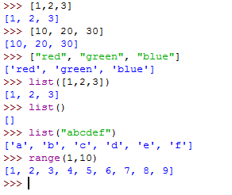
4.3 Lists
A list is a ordered set of values, where each value is identified by an index
The values of a list are called elements
The order of an element in a list is called index
Creation
Enclose elements in square brackets ([ ])
Use the list constructor

Slide 8
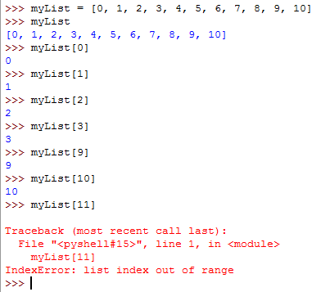

4.3 Lists
Accessing elements
An element at the index position in a list can be accessed using the syntax
listName[index]

Slide 9




4.3 Lists
Operations with Lists
Finding the number of elements in a list – the length of a list
Finding smallest element in a list
Finding largest element in a list
Computing the sum of all elements
len(listName)
min(listName)
max(listName)
sum(listName)

Slide 10


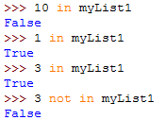

4.3 Lists
Operations with Lists
Getting a slice from a list from index start to index end-1
Shuffle the elements randomly in a list
+, *, in, not in operators
listName[start:end]
random.shuffle(listName)

Slide 11
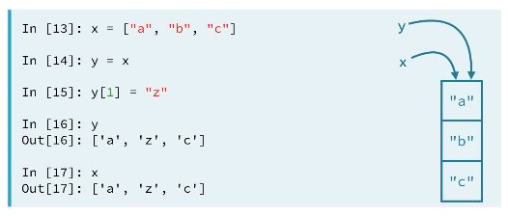
4.3 Lists

Slide 12
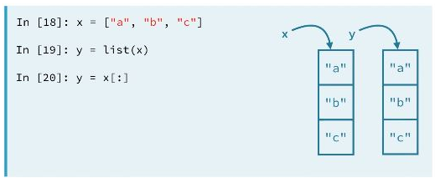
4.3 Lists

Slide 13
4.3 Lists
List Methods
Add an element to the list
list.append(x)
Insert an item at a given position
list.insert(i, x)
Remove the first item from the list whose value is x
list.remove(x)
Remove the item at the given position in the list, and return it.
list.pop([i]); If no index is specified, a.pop() removes and returns the last item in the list.

Slide 14
4.3 Lists
List Methods
Return the index in the list of the first item whose value is x.
list.index(x)
Return the number of times x appears in the list.
list.count(x)
Sort the items of the list, in place
list.sort()
Reverse the elements of the list, in place.
list.reverse()

Slide 15

4.5 File Access
How data can be stored when
We want to access the program results next time when the program starts without re-analysing the data?
We want to access the data using another computer?
Files

Slide 16
4.5 File Access
Relative vs. Absolute filename
An absolute filename contains a filename with its complete path
A relative filename is relative to its current working directory
File Input & Output Operations
Open
Write
Read
Close

Slide 17
4.5 File Access
Open files
Use the open function
Specify the filename (filename)
Specify how the file will be used (mode)
filevariable = open(filename, mode)

Slide 18
4.5 File Access
File modes
Model | Description
“r” | Opens a file for reading
“w” | Opens a new file for writing. If the file already exists, its old contents are destroyed
“a” | Opens a file for appending data from the end of the file
“rb” | Opens a file for reading binary data
“wb” | Opens a file for writing binary data

Slide 19

4.5 File Access
Example
Close file
myfile = open('file.txt','w')
print(myfile)

Slide 20
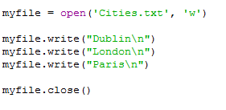
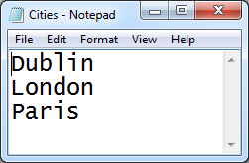
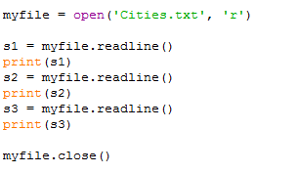
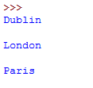
4.5 File Access
Write data
Read data

Slide 21

4.5 File Access
Exercise: Examine the following methods
read with no parameters
read with an integer as parameter
readlines
Exercise: Examine the following code

